Slide 1

Classical and Quantum Statistics

Slide 2
Classical Statistics:
Classical statistics or Maxwell-Boltzmann (MB) Statistics was successful in explaining pressure, temperature etc. of gaseous systems but couldn’t explain some experimental results like the energy distribution in case of blackbody radiation, specific heat at low temperature etc.
Such phenomena were successfully explained by S.N. Bose, Albert Einstein, Enrico Fermi, P.A. Dirac with the help of newly discovered quantum theories.These new statistics are known as Quantum Statistics.

Slide 3
Quantum Statistics:
Bose-Einstein (BE) statistics
Fermi-Dirac (FD) statistics

Slide 4
Maxwell-Boltzmann (MB) Statistics:
The basic postulates associated with the MB statistics are-
The particles of the system are identical and distinguishable.
The phase space can be divided into a very large number of cells.
There is no restriction on the number of particles which can occupy a single phase cell.
The available volume of the phase space cell can be very small and may even approach zero.
The total number of particles in the system remains constant.
The total energy of the system remains constant.

Slide 5
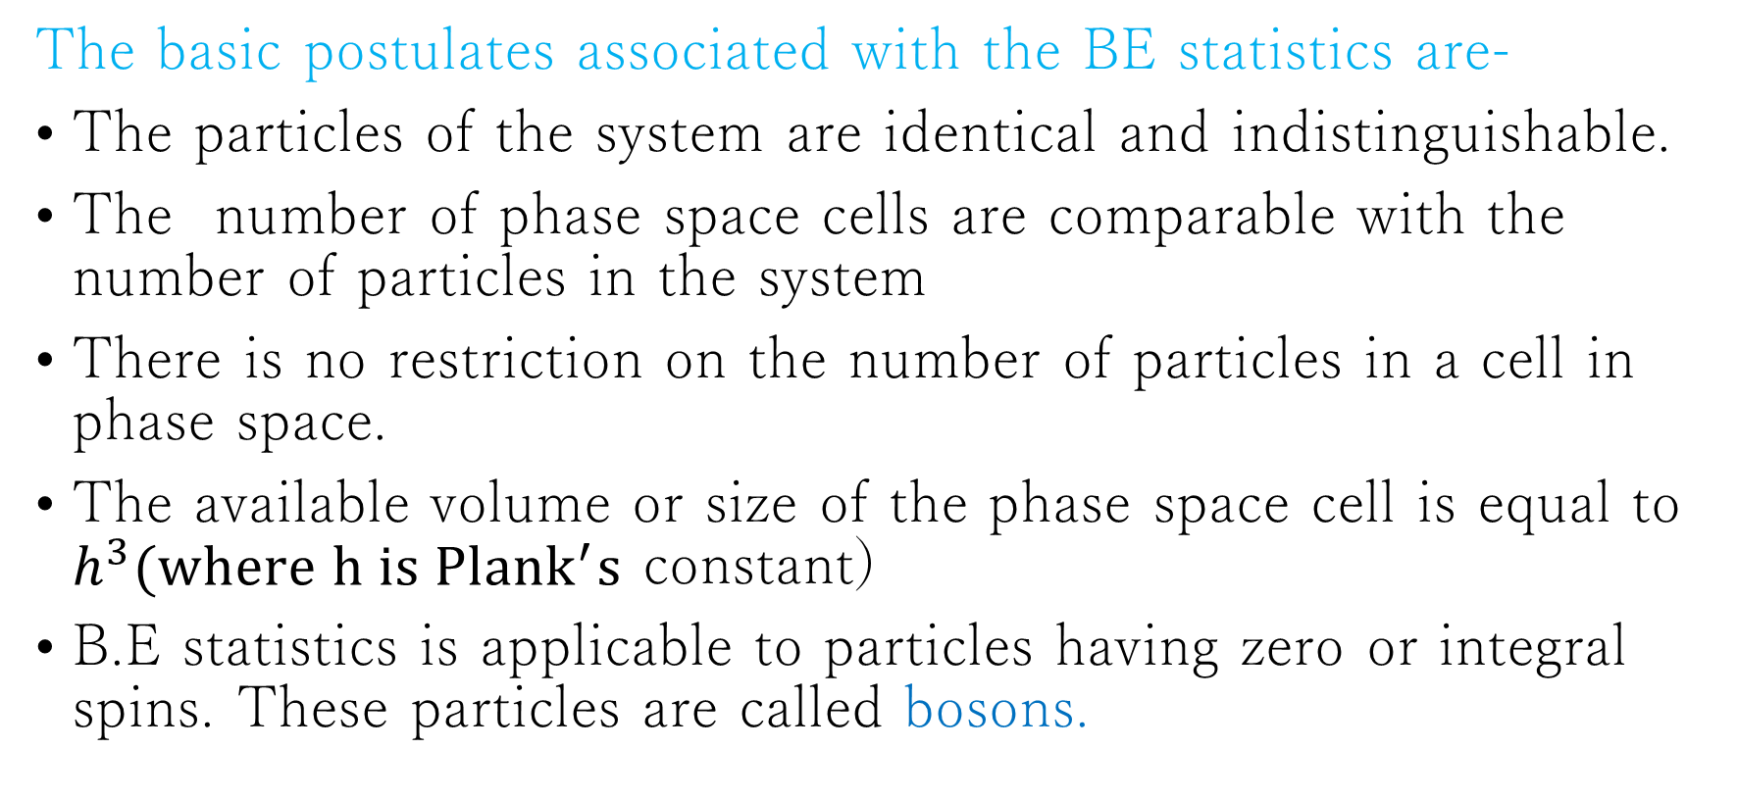
Bose-Einstein’s (B.E) Statistics:
The basic postulates associated with the BE statistics are-
The particles of the system are identical and indistinguishable.
The number of phase space cells are comparable with the number of particles in the system
There is no restriction on the number of particles in a cell in phase space.
The available volume or size of the phase space cell is equal to $h^{3}(where h is {Plank}^{′}s$ constant)
B.E statistics is applicable to particles having zero or integral spins. These particles are called bosons.

Slide 6
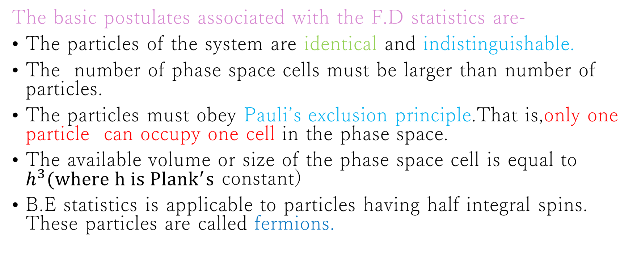
Fermi-Dirac Statistics:
The basic postulates associated with the F.D statistics are-
The particles of the system are identical and indistinguishable.
The number of phase space cells must be larger than number of particles.
The particles must obey Pauli’s exclusion principle.That is,only one particle can occupy one cell in the phase space.
The available volume or size of the phase space cell is equal to $h^{3}(where h is {Plank}^{′}s$ constant)
B.E statistics is applicable to particles having half integral spins. These particles are called fermions.

